Slide 1
Ya gotta make it obvious
Terence Parr
MSDS program University of San Francisco

Slide 2
A bit of background…
I'm retooling as a machine learning droid after an entire career in parsing and programming language implementation (you might know me as "the ANTLR guy")
Since I'm no longer subject to the paper count treadmill, I'm exploring less traditional scholarly work, such as creating state-of-the-art visualizations and animations to explain machine learning concepts and models: https://explained.ai/
My mission is to explain complex topics deeply, but in the simplest possible way, and to build useful libraries to help the research and education community
My niche: what industry can't justify and academia doesn't value

Slide 3
What's wrong w/traditional academic output?
The goal of academic research papers and instruction is to transmit ideas, but…
Peer review and our egos often work against this goal because they are the enemy of simplicity and clarity
We fear that simplicity implies small research contribution and we also want to impress our audience with our brilliance
Therefore, we "math it up" or simply don't bother spending time to make our techniques or results clear
We should value simple and clear expositions most of all, for both large and small contributions, even if it's lots of extra work
Try to illuminate not impress!

Slide 4
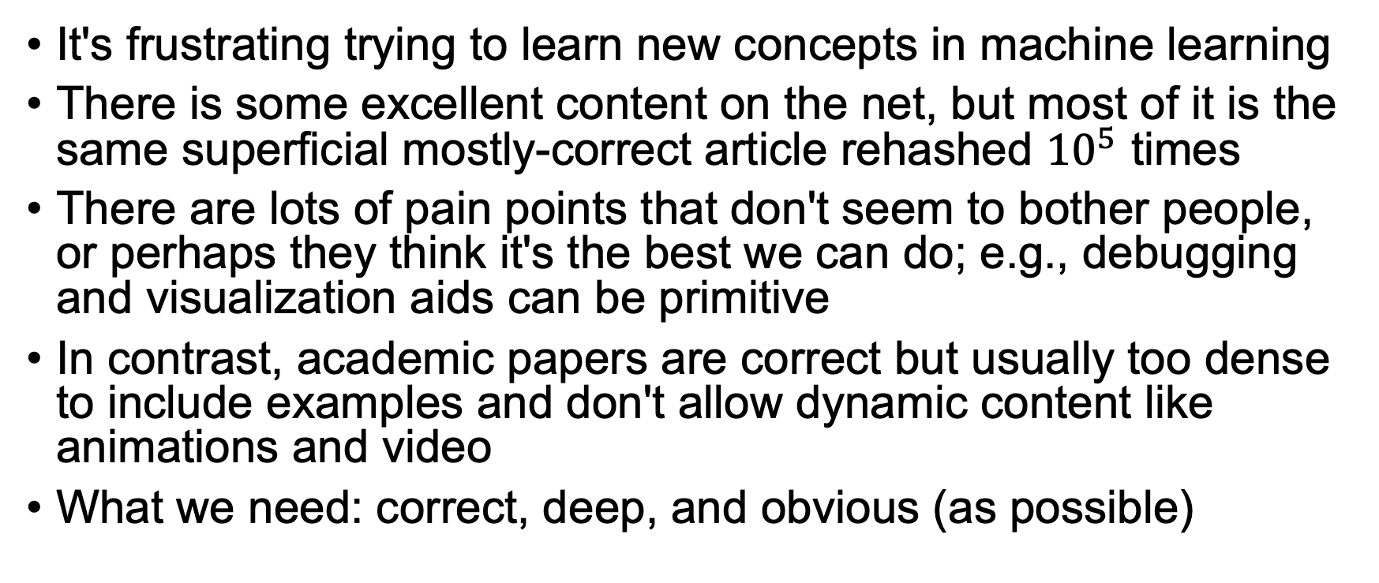
What's wrong with articles and lectures?
It's frustrating trying to learn new concepts in machine learning
There is some excellent content on the net, but most of it is the same superficial mostly-correct article rehashed ${10}^{5}$ times
There are lots of pain points that don't seem to bother people, or perhaps they think it's the best we can do; e.g., debugging and visualization aids can be primitive
In contrast, academic papers are correct but usually too dense to include examples and don't allow dynamic content like animations and video
What we need: correct, deep, and obvious (as possible)

Slide 5

Advice on achieving "correct, deep, and obvious"
If you aim to transmit ideas/techniques: Seek a deep understanding
Ask why or how something works; be able to reproduce the technique
W/o depth, we can't get to the essence, can't zero in on the critical idea
W/o essence, we can't strip away any mysticism (I'm talkin to you neural nets!)
Can you describe the essence in one key phrase or sentence?
Target the human visual cortex in your artifacts
Rederive everything and baby step the audience to the solution; don't start with the final math solution, for example
You can't build what you can't imagine; don't limit yourself by what's possible or what you know how to build; engage your audience!
Sometimes you are right and everyone else is wrong

Slide 6
Some examples following this advice

Slide 7
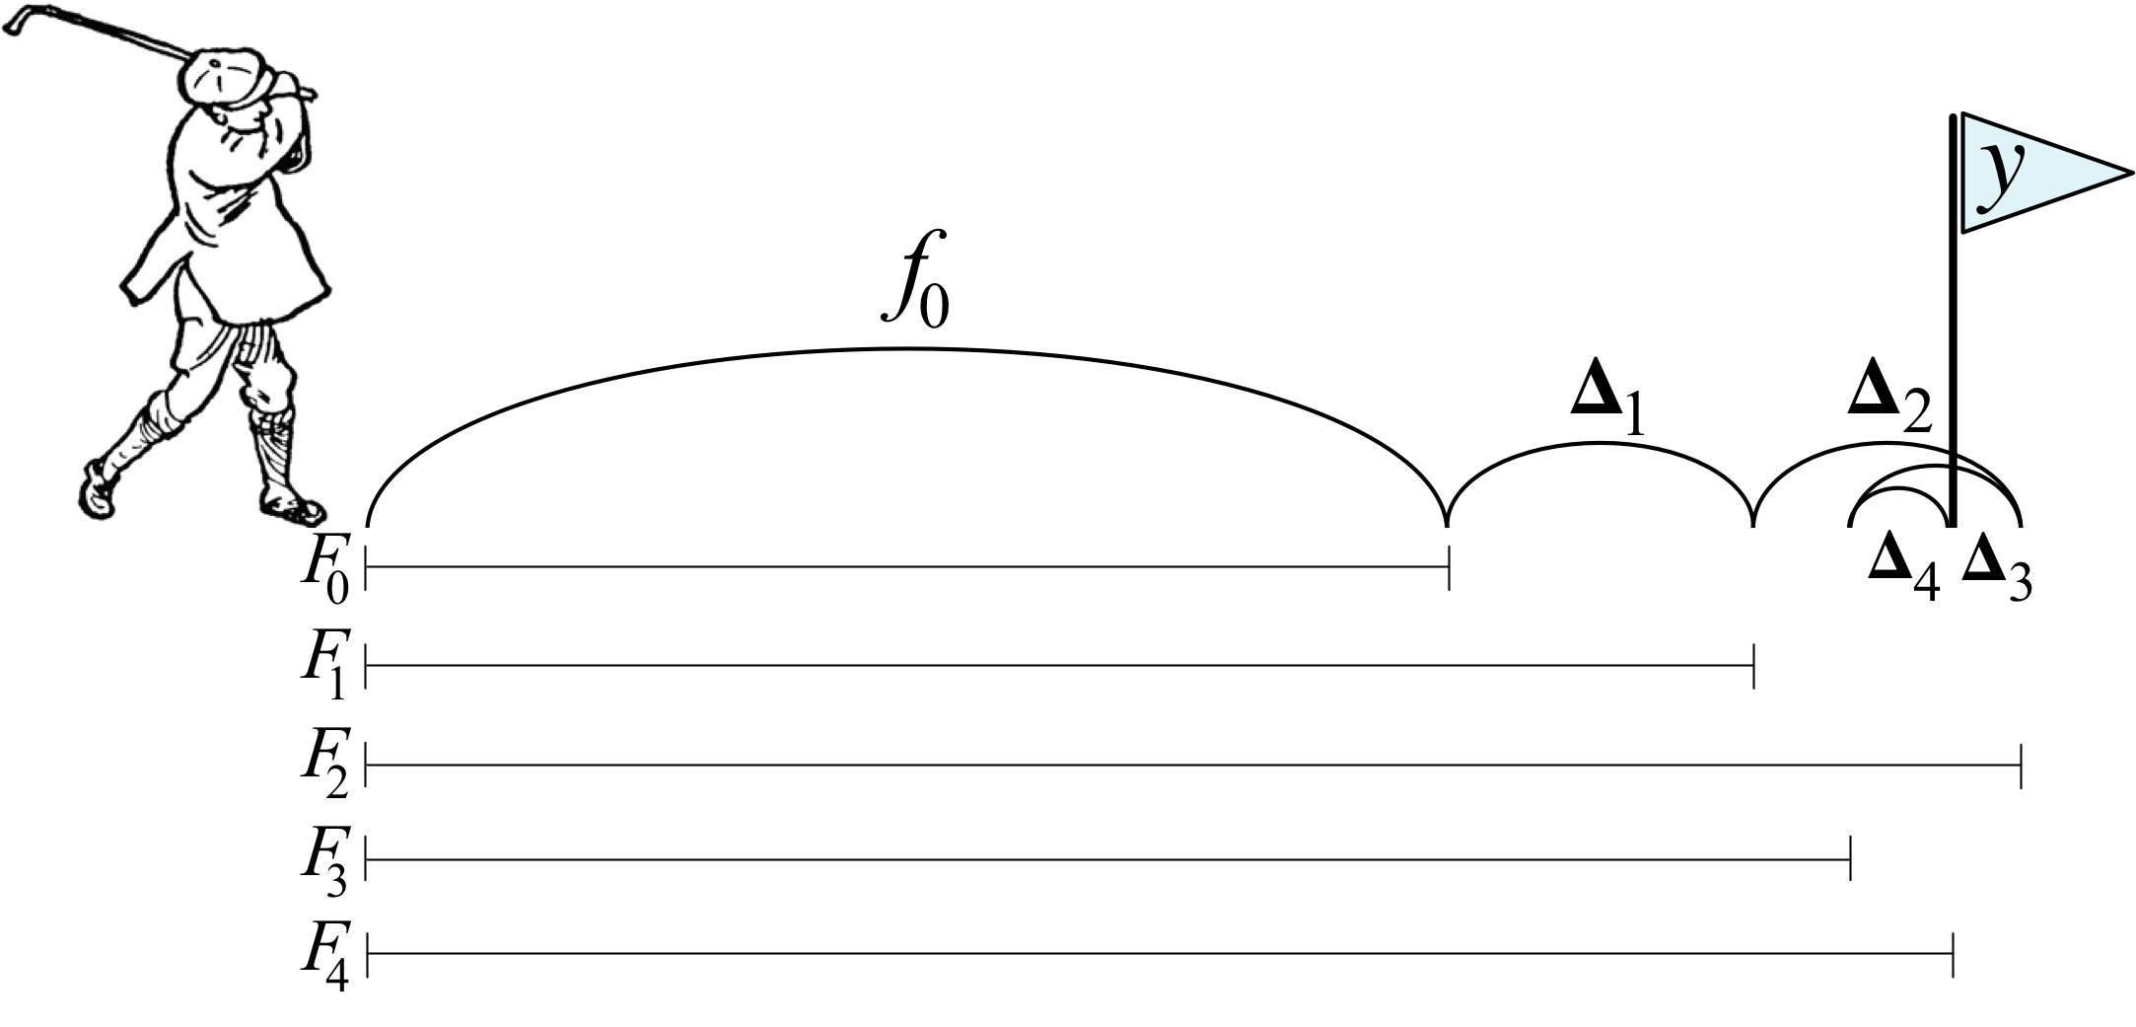

Explaining gradient boosting (regression)
Start by isolating the essence of boosting; boil it down!
Boosting is just the addition of an initial "drive" $f_{0}$ plus a series of imprecise "putts" $Δ_{i}$
Next, design a visualization that clearly shows the key bits
Diagram from https://explained.ai/gradient-boosting/index.html
but golfer clipart from http://etc.usf.edu/clipart/

Slide 8
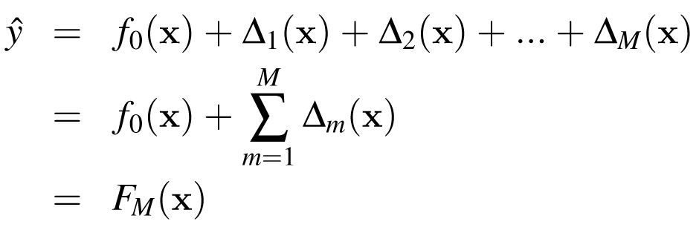
Explaining gradient boosting (regression)
Then, with this intuition, show the concise equation that embodies the process:
Don't start with the math!
The math is the condensation of an inventor's intuition
The inventor didn't start with the answer; why should our audience have to?
Teach others to invent by showing your work, even the false paths

Slide 9
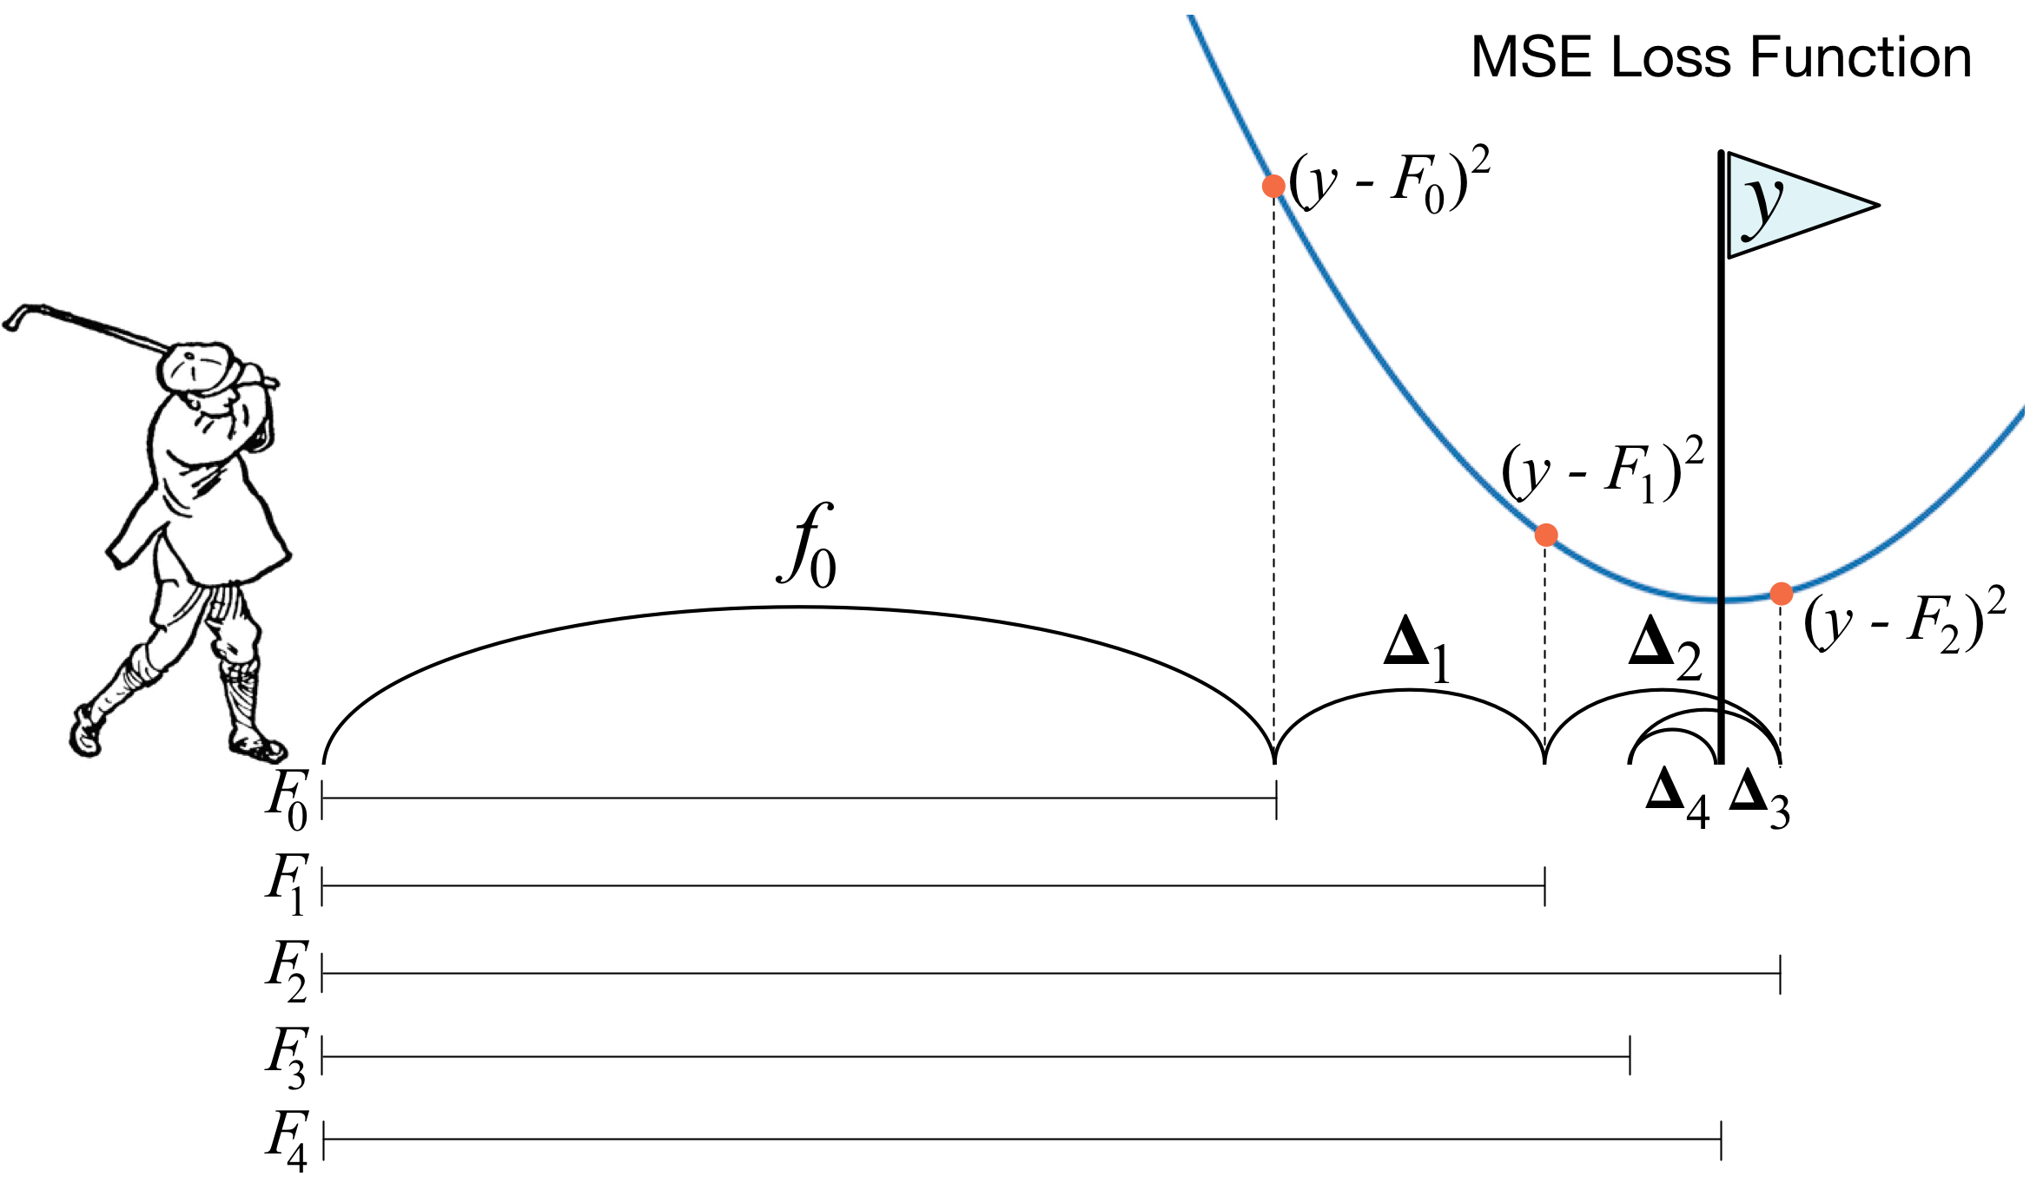

While we're at it… GBMs: Gradent descent in function space
A statistician and a mathematician walk into a bar…
Clarifying a common fuzzy detail
Difference $y−\hat{y}$ is not just a vector; it's a gradient, and of the MSE loss function ${\left(y−\hat{y}\right)}^{2}$
Chasing the difference vector performs MSE gradient descent in prediction space
See https://explained.ai/gradient-boosting/descent.html#sec:3.2 for more details

Slide 10
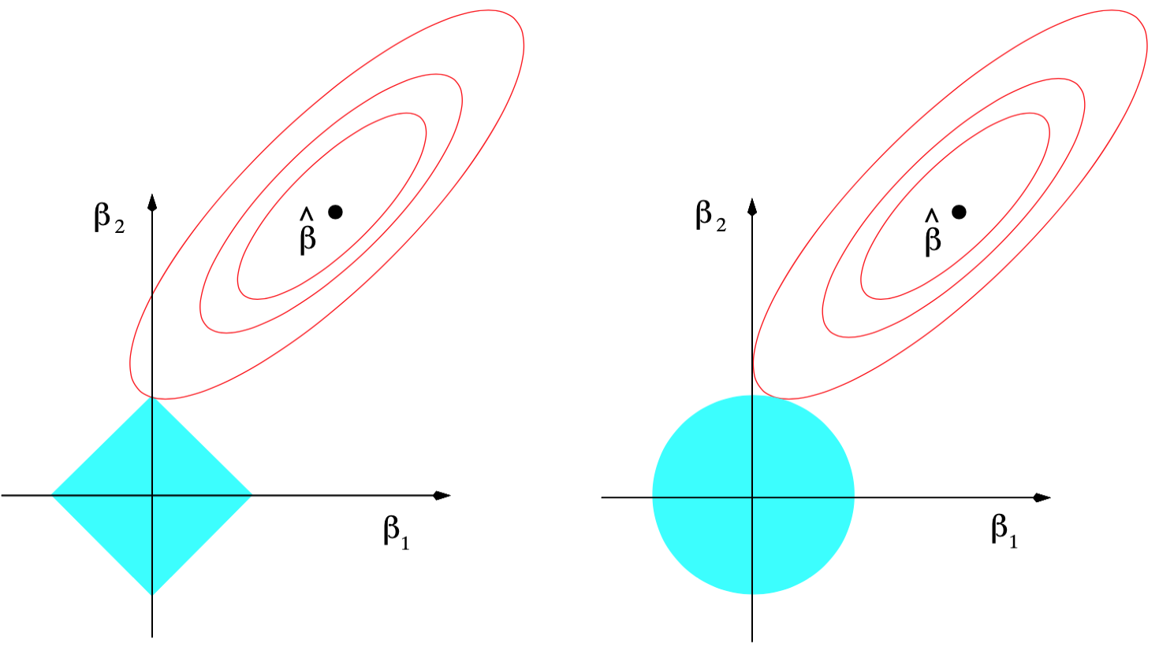
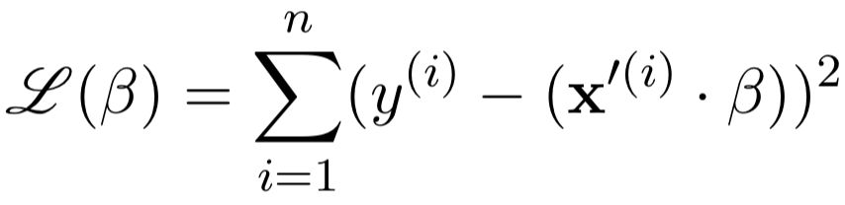
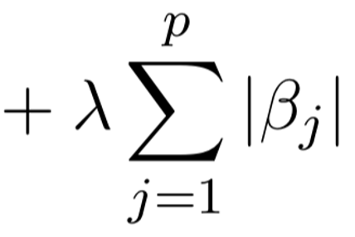
Just because it's visual doesn't mean it's effective
Viz meant to help explain L1 vs L2 regularization and why L1 encourages zero coefficients but L2 does not
(ESL is a great book written by brilliant statisticians, but these visualizations never helped me)
Don't show this math first:
Why here?
For one thing, the pictures don't correspond to that math!!!
L1 regularization (lasso)
L2 regularization (ridge)
Fig 3.11, Page 71 Elements of Statistical Learning

Slide 11
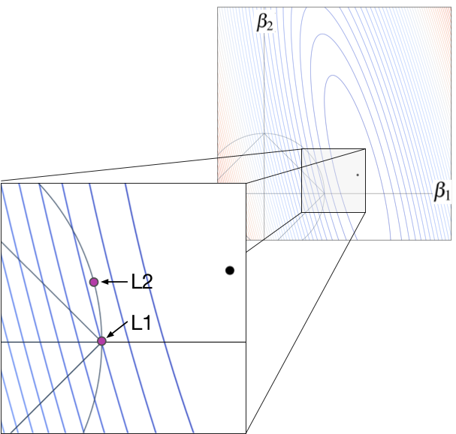
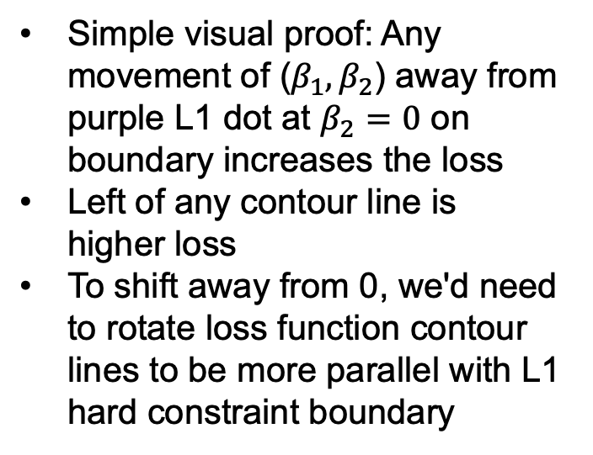
Better L1 vs L2 explanation
Loss function with two parameters
Simple visual proof: Any movement of ($β_{1},β_{2}$) away from purple L1 dot at $β_{2}=0$ on boundary increases the loss
Left of any contour line is higher loss
To shift away from 0, we'd need to rotate loss function contour lines to be more parallel with L1 hard constraint boundary
higher lower
min
Took me a year of playing with visualizations before settling on this
From https://explained.ai/regularization/index.html

Slide 12
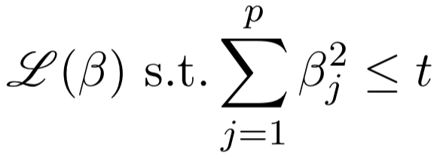
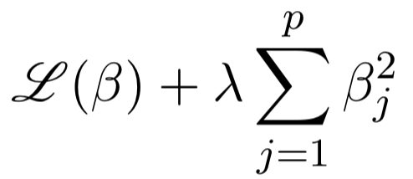
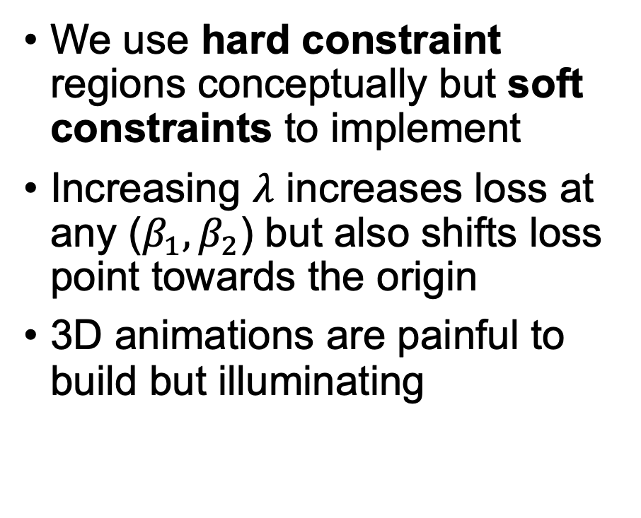
Sometimes animations and 3D help
We use hard constraint regions conceptually but soft constraints to implement
Increasing $λ$ increases loss at any ($β_{1},β_{2}$) but also shifts loss point towards the origin
3D animations are painful to build but illuminating
becomes

Slide 13
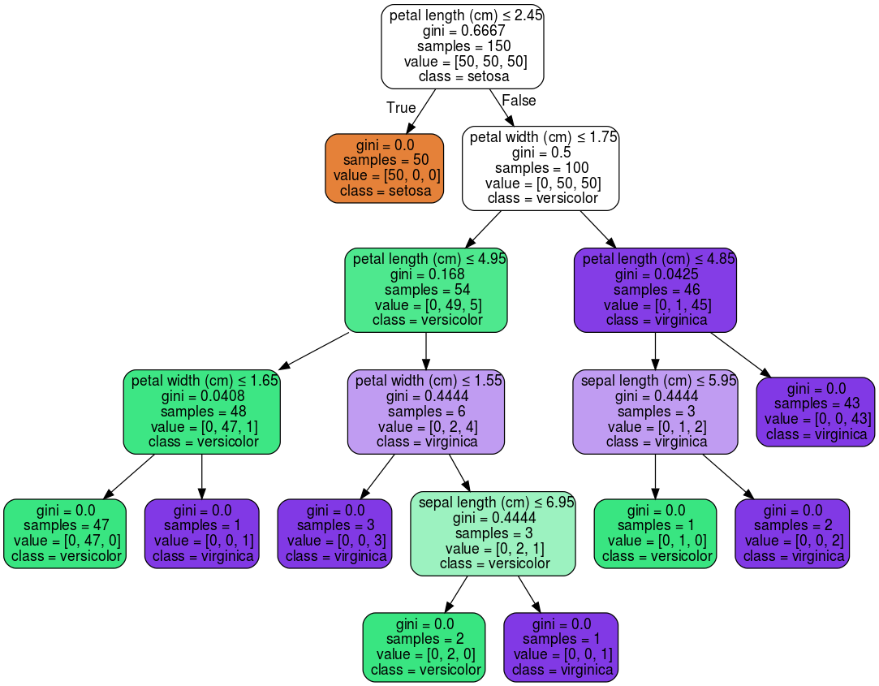
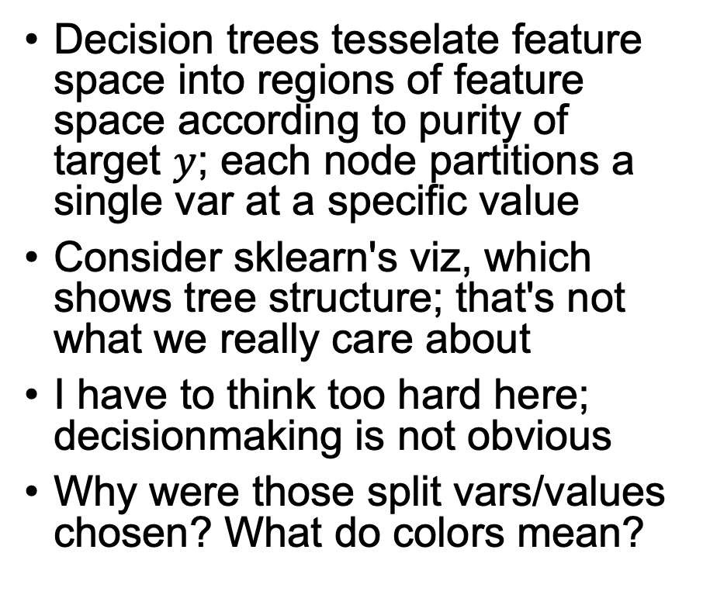
Let your imagination and deep understanding be your guide
Toy iris data set,
sklearn viz
Decision trees tesselate feature space into regions of feature space according to purity of target $y$; each node partitions a single var at a specific value
Consider sklearn's viz, which shows tree structure; that's not what we really care about
I have to think too hard here; decisionmaking is not obvious
Why were those split vars/values chosen? What do colors mean?

Slide 14
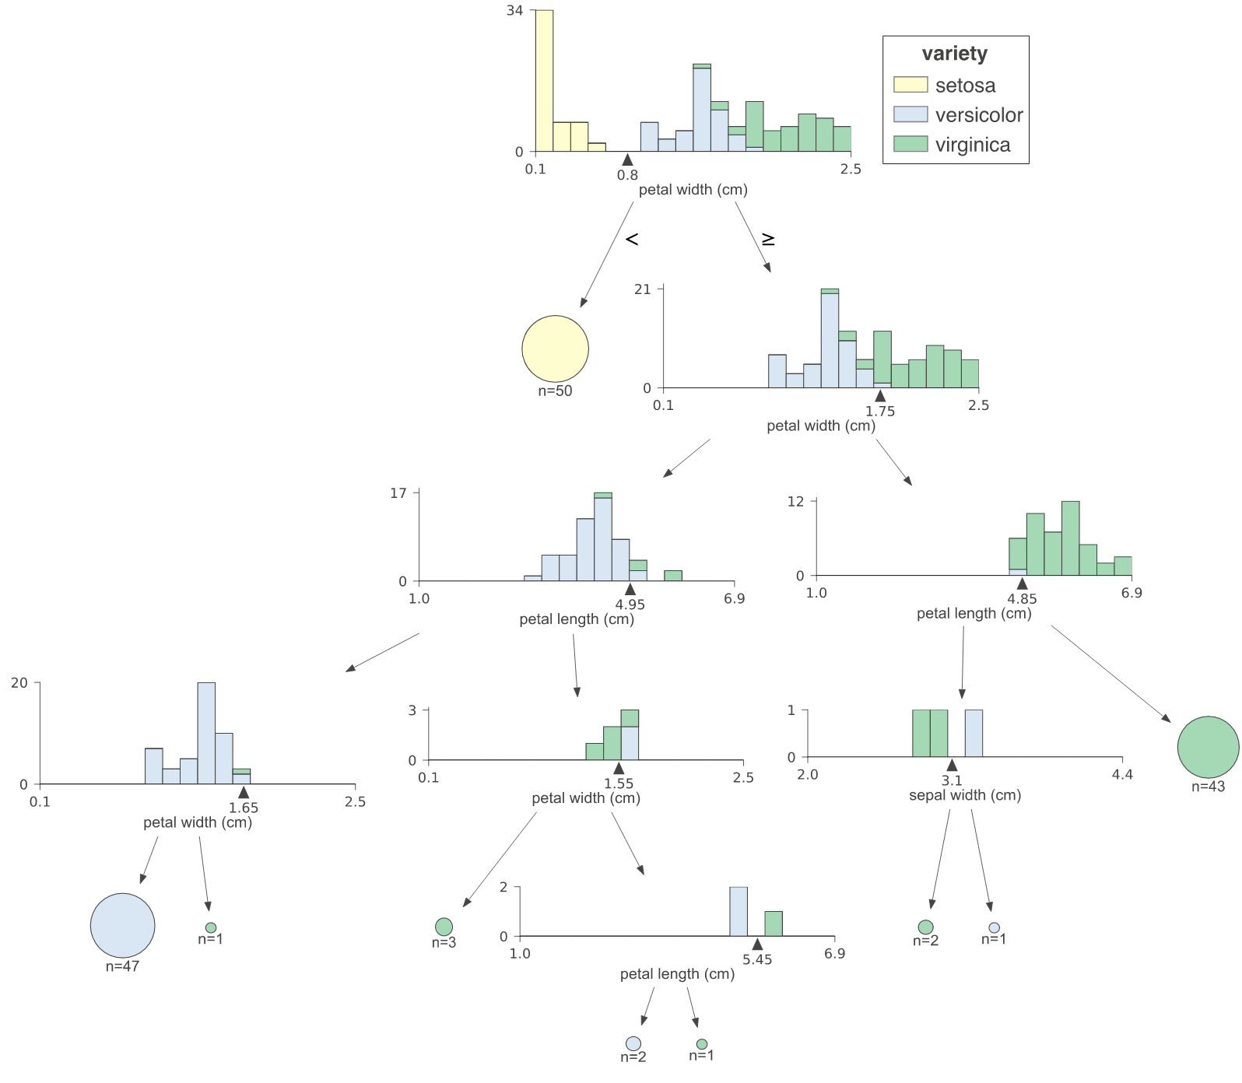
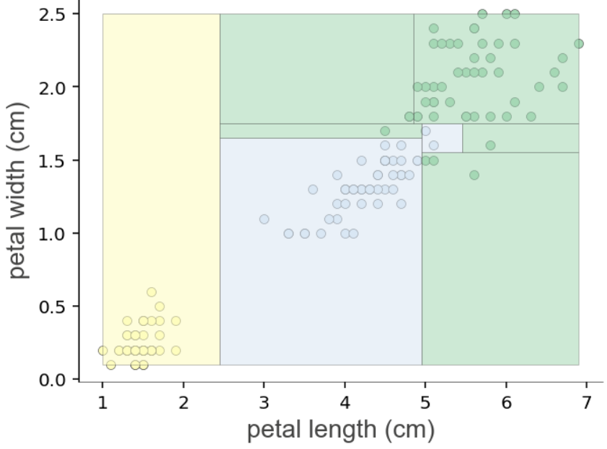
Illustrate the key ideas
Split point rationale is now obvious
Effect How
See https://explained.ai/decision-tree-viz/index.html

Slide 15
Debugging matrix algebra is not obvious
We often get less than helpful exception messages:
C++?
h_ = torch.tanh(Whh_ @ (r*h) + Uxh_ @ X.T + bh_)
RuntimeError: size mismatch, m1: [764 x 256], m2: [764 x 200] at /tmp/pip-req-build-as628lz5/aten/src/TH/generic/THTensorMath.cpp:41
It's not clear why/where expression failed; I still have to think hard
We need operator and operands; TensorSensor generates:
Cause: @ on tensor operand Uxh_ w/shape [764, 256]
and operand X.T w/shape [764, 200]
See https://explained.ai/tensor-sensor/index.html

Slide 16
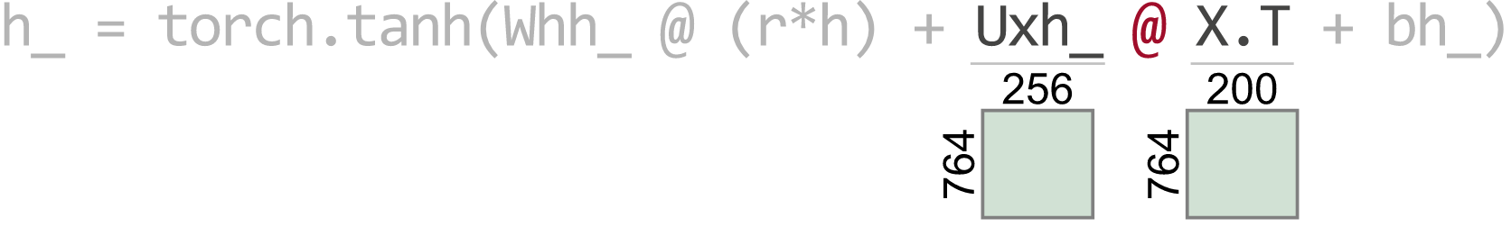
Better yet: make it obvious with a viz
Cause: @ on tensor operand Uxh_ w/shape [764, 256]
and operand X.T w/shape [764, 200]
(Notice the details like highlighting, red operator color, and de-highlighting)
See https://explained.ai/tensor-sensor/index.html

Slide 17
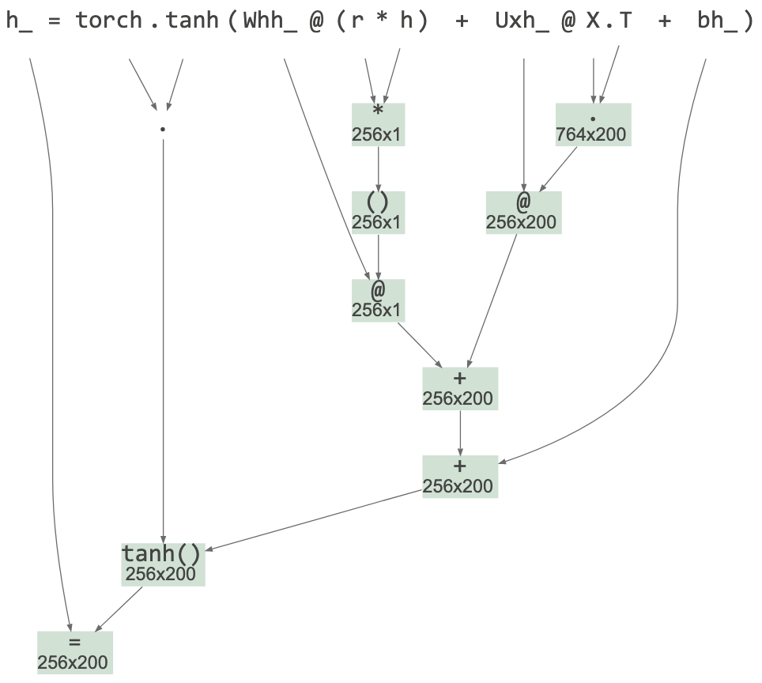
While we're at it… Aid for reading matrix code
What do we care about when reading complex matrix expressions?
We need the shape of all subexpressions
Abstract syntax tree gives us an obvious viz with matrix dimensions

Slide 18
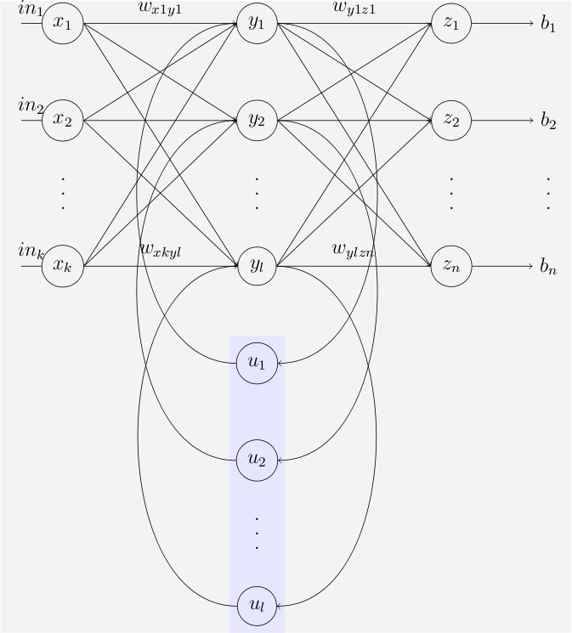
RNNs / neural nets are cloaked in mysticism
I don't think the neural net analogy is helpful anymore
The tangle of connections between neurons obscures rather than clarifies
What exactly does that diagram portray?
Image credit Fyedernoggersnodden https://en.wikipedia.org/wiki/Recurrent_neural_network

Slide 19
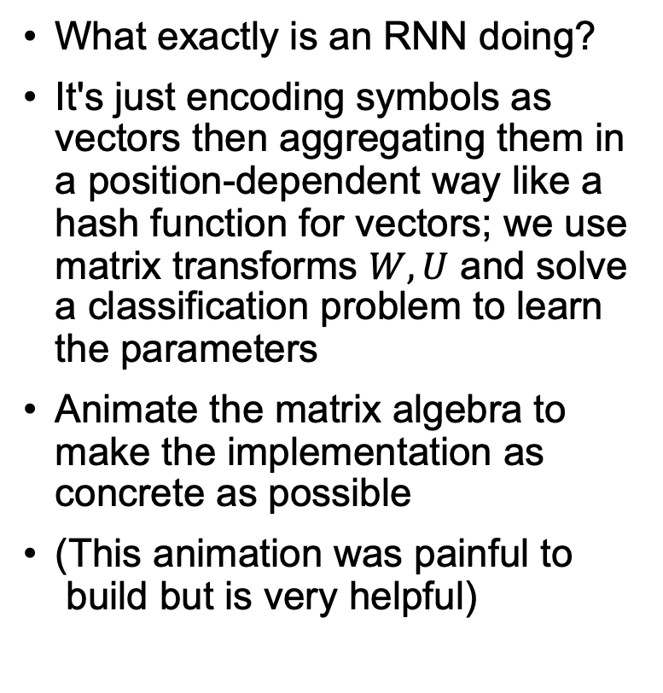

Strip away the mysticism
Classify cat words to language
What exactly is an RNN doing?
It's just encoding symbols as vectors then aggregating them in a position-dependent way like a hash function for vectors; we use matrix transforms $W,U$ and solve a classification problem to learn the parameters
Animate the matrix algebra to make the implementation as concrete as possible
(This animation was painful to build but is very helpful)
(Notice weights $W,U,V$ flash when updated)
See https://explained.ai/rnn/index.html

Slide 20
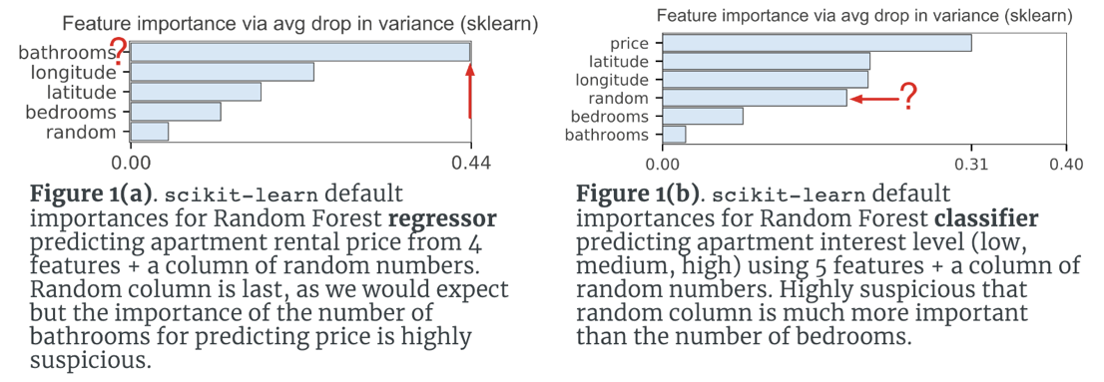
Be skeptical and confident: Sometimes everybody else is wrong and you are right
Gini/var drop importance for random forests can be wildly wrong
See https://explained.ai/rf-importance/index.html

Slide 21
Some final advice
Be tenacious; never let the computer win; bash your way to victory; deep understanding and clear visualizations often require pathological determination and a trail of dead code
When you feel coding or learning pain, work hard to erase it; crave beauty, excellence, and simplicity
Go the extra step: create libraries or other artifacts that help others in the community even if academia doesn't value them

Slide 22
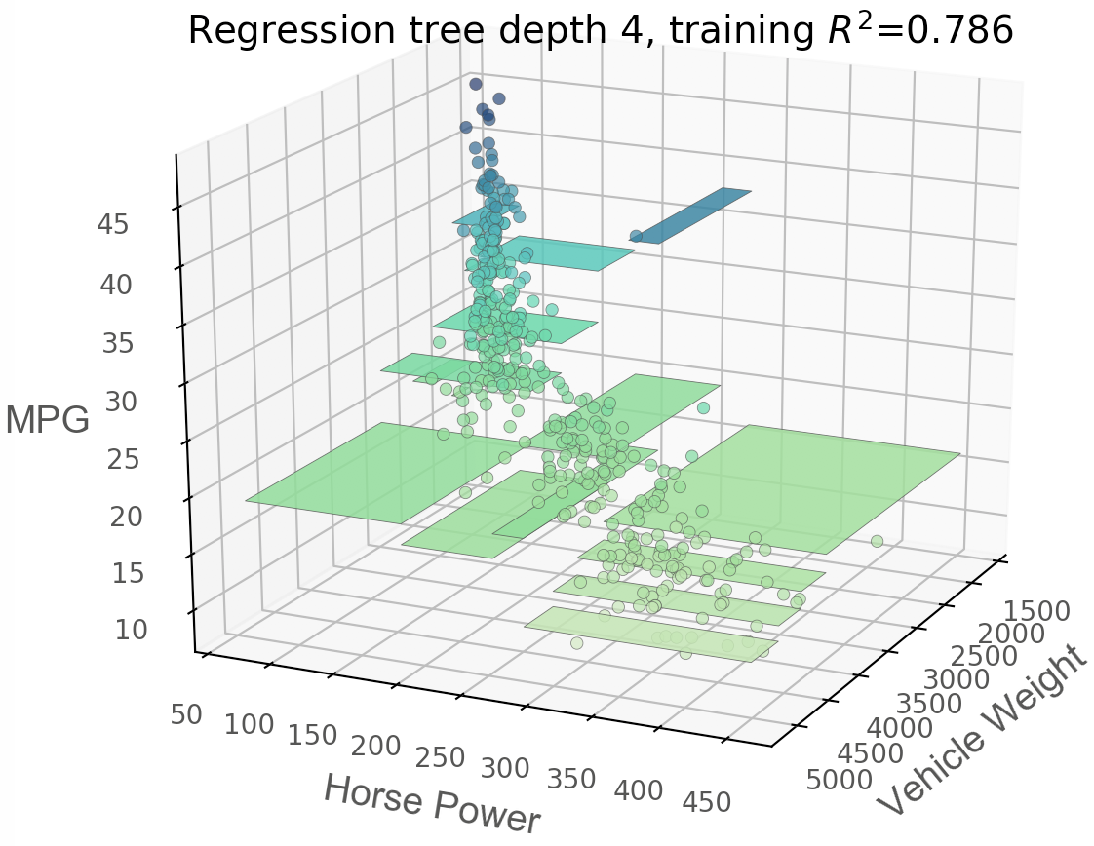
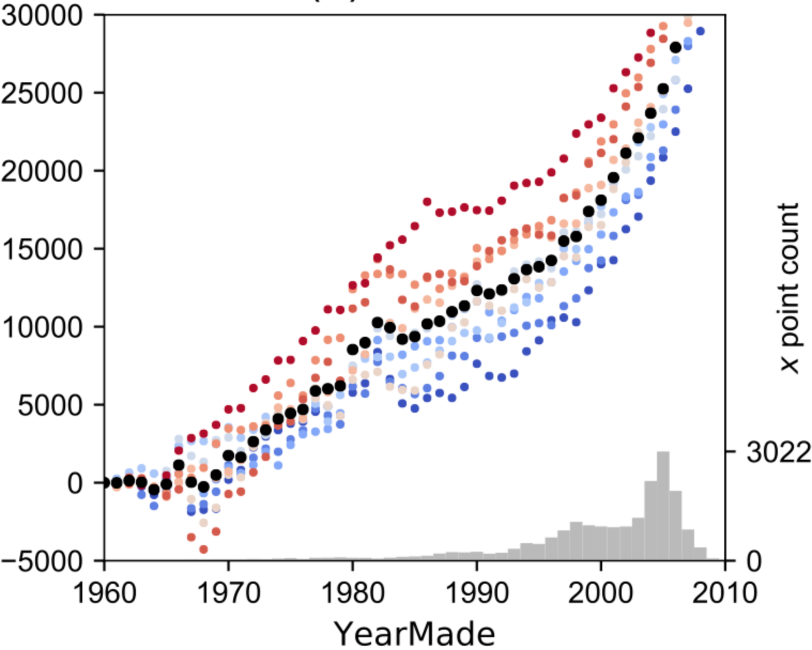
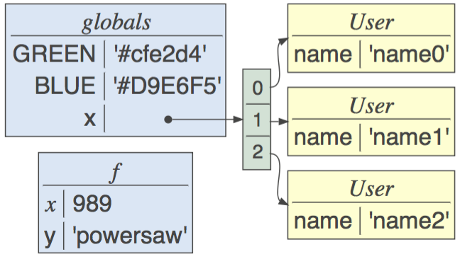
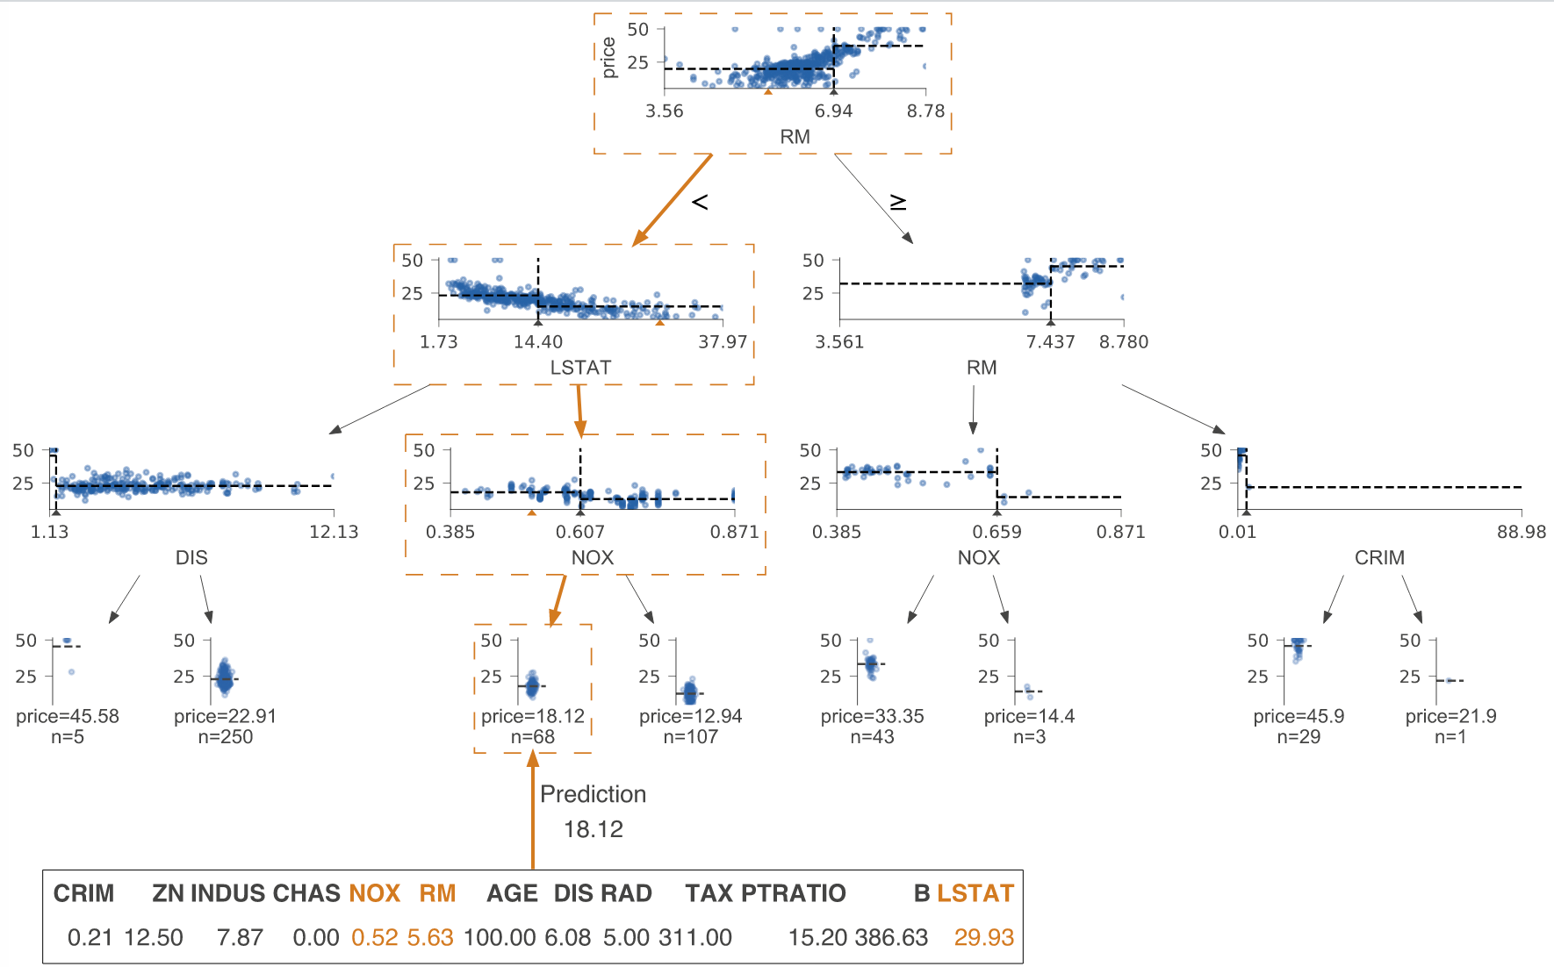
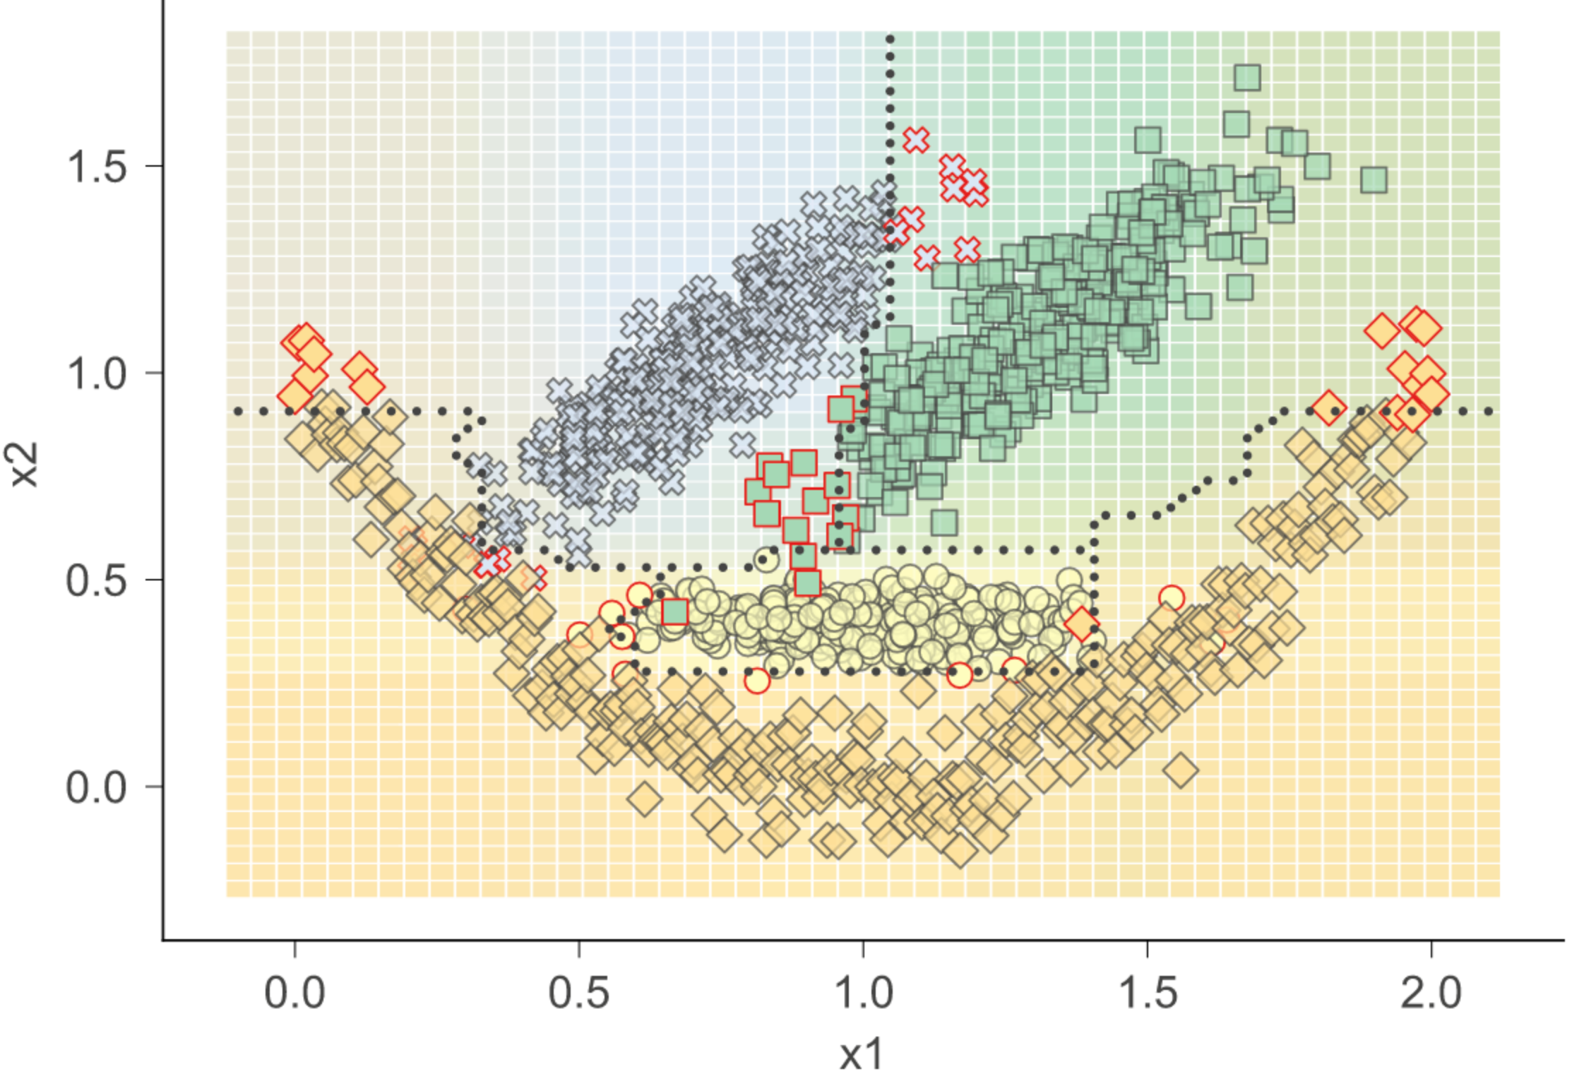
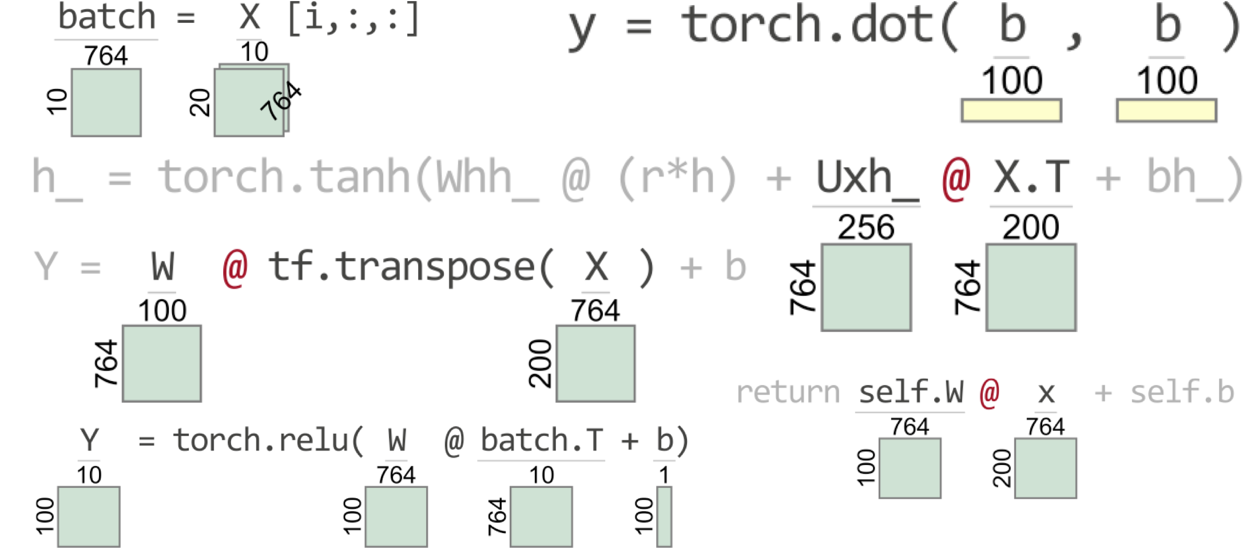
Publish open source libraries!
stratx
lolviz
dtreeviz
dtreeviz
TensorSensor

